Slide 1
Graph Theory Lab Results
Florian Speer & Nils Schröder
17.01.2025

Slide 2
Methodology
Invariant Analysis
Identify the most promising invariants (execution time vs number of clusters)
Isomorphism Analysis
Find the overall fastest invariant including the isomorphism checks
Isomorphism Scaling Analysis
Investigate the asymptotic scaling

Slide 3
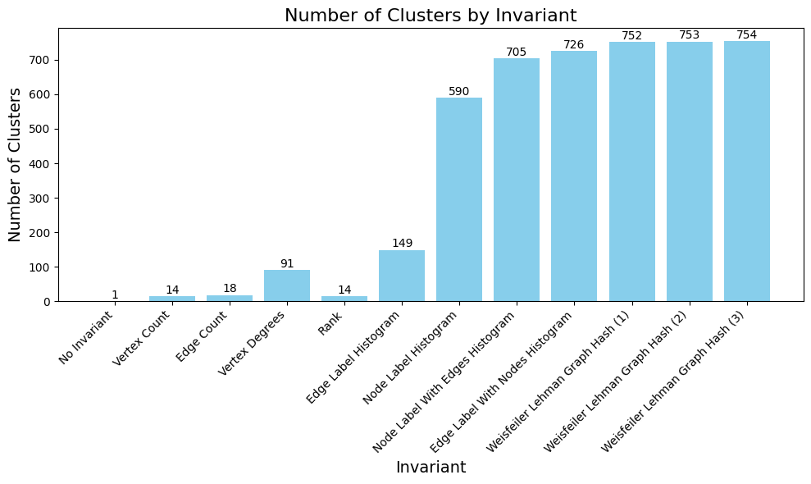
Invariant analysis
Total number of cluster = 754
Notes:
Number of cluster (bar chart sample size 1)
Execution time
Num cluster / ms
Variance (definition + bar chart)

Slide 4
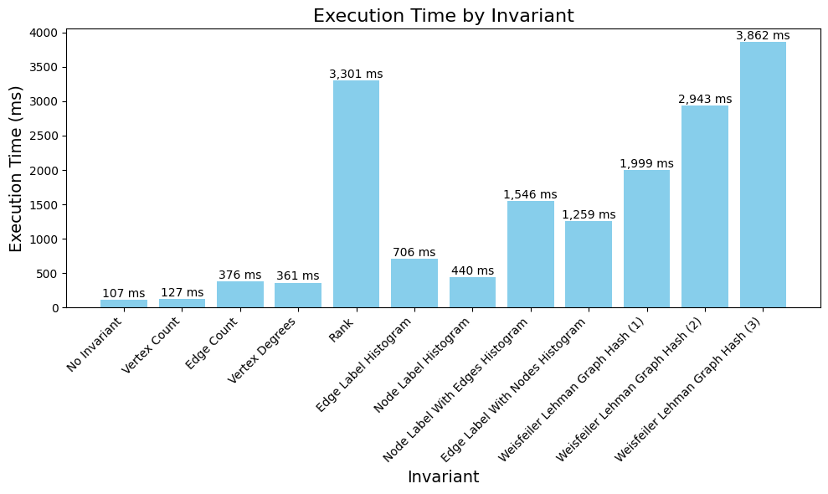
Invariant analysis
Notes:
Number of cluster (bar chart sample size 1)
Execution time
Num cluster / ms
Variance (definition + bar chart)

Slide 5
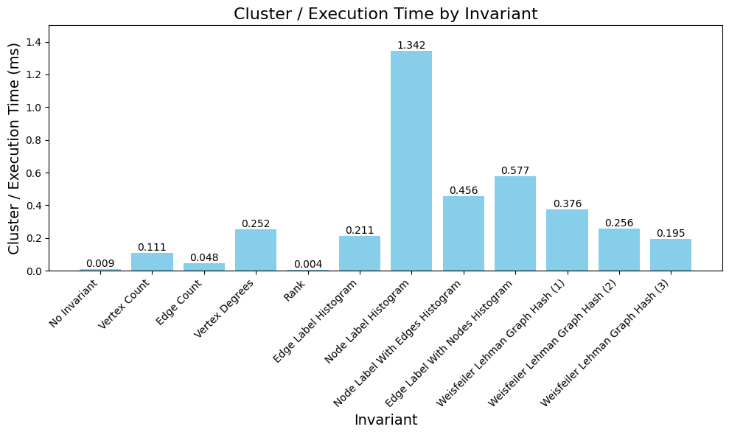
Invariant analysis
Notes:
Number of cluster (bar chart sample size 1)
Execution time
Num cluster / ms
Variance (definition + bar chart) <- 3 charts reichen glaube ich

Slide 6
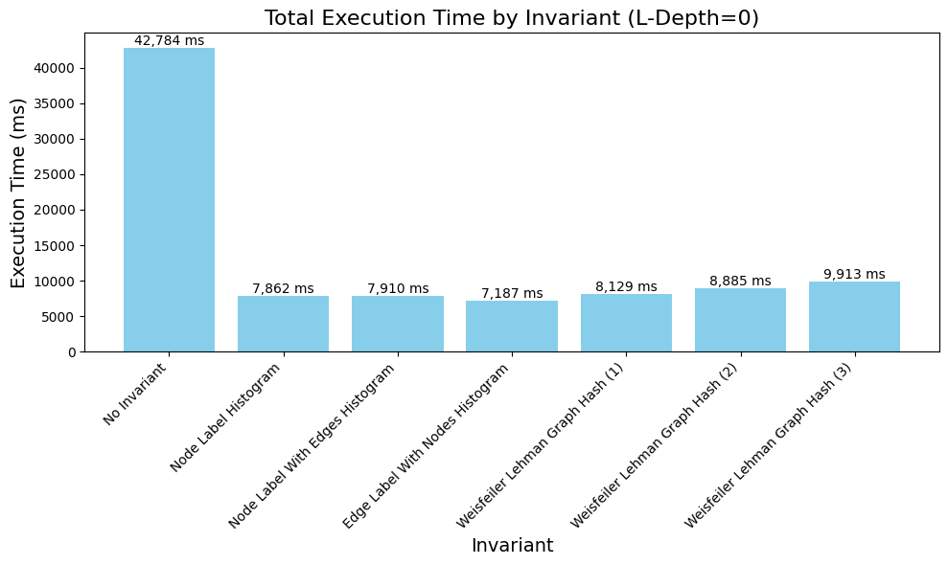
Isomorphism Analysis
Notes:
L-depth growth (execution time lineplot)
Execution time (bar chart l-depth 0)

Slide 7
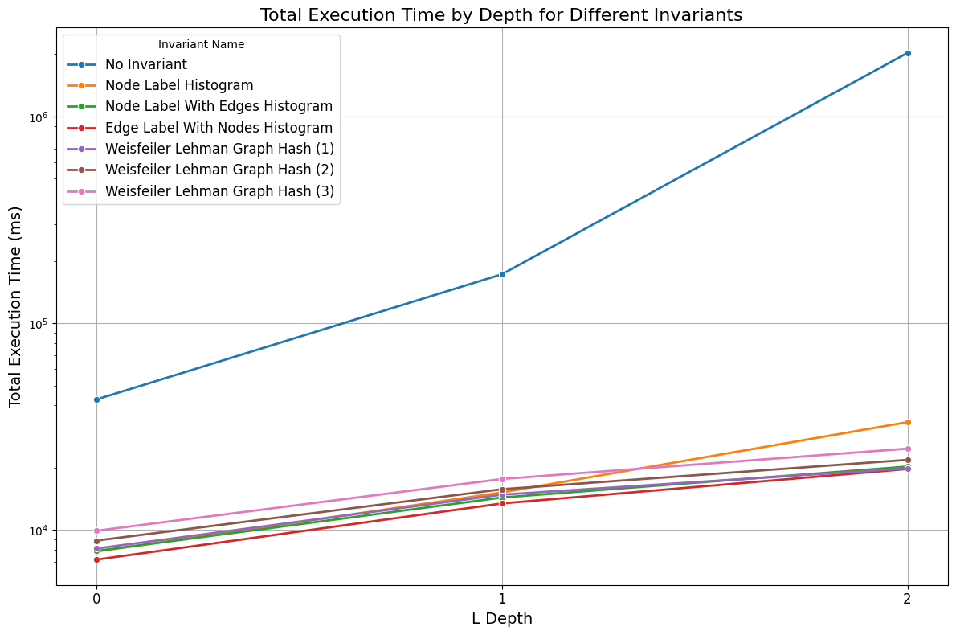
Isomorphism Analysis
Notes:
L-depth growth (execution time lineplot)
Execution time (bar chart l-depth 0)

Slide 8
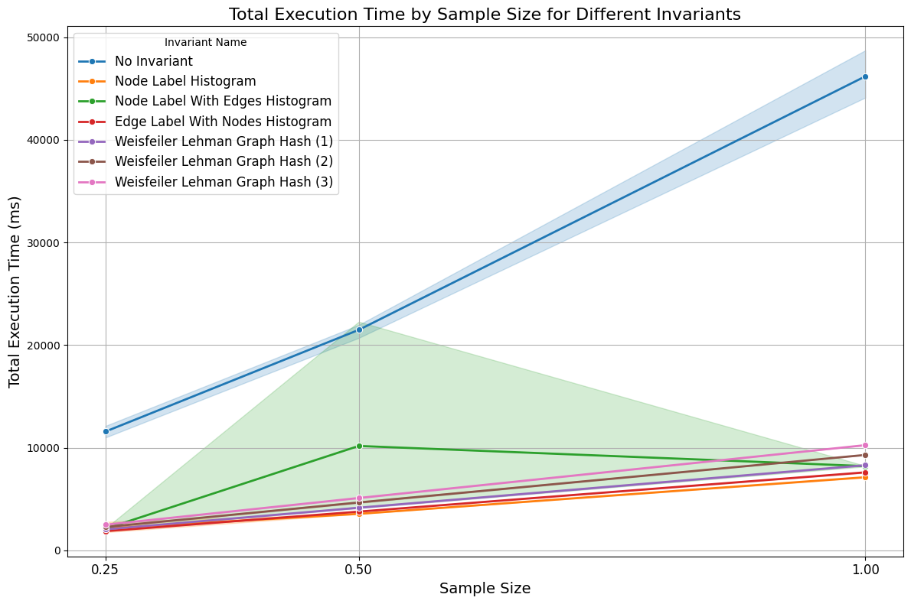
Isomorphism Scaling Analysis
L-Depth=0
Notes:
Sample size growth (execution time lineplot)
Number of checks (cluster growth)
Vs cluster growth with increasing l-depth

Slide 9
CONCLUSION
Number of clusters has a larger influence on execution time than number of total reactions
Node Label Histogram produces large number of clusters in short time
Weisfeiler Lehman Graph Hash in 3 Iterations already finds all clusters for L-Depth [0-2]
Notes:
Sample size growth (execution time lineplot)
Number of checks (cluster growth) <- same as time axis
Vs cluster growth with increasing l-depth

Slide 10
Vielen Dank!

